Slide 1
IOT & Wearable Prototyping
Kane, Kapil/Lu, Ken
2014/08/24

Slide 2
Agenda
Prototype 1: Easyconnect as IoT – 1 (Data from Cloud)
Prototype 2: Easyconnect as IoT – 2 (Real-time Data)
Prototype 3: iBeacon

Slide 3
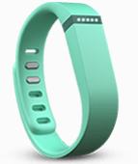
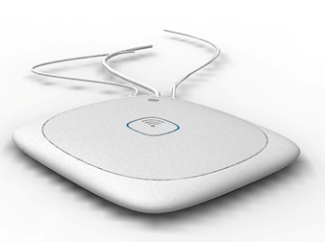
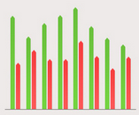
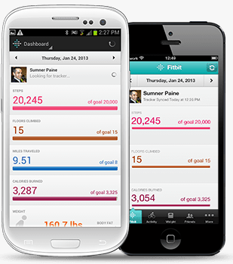
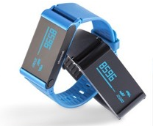
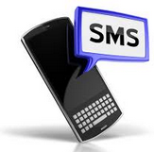
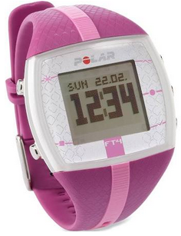
Prototype 1: Easyconnect as IoT Hub – 1 - Data from cloud
Our SW Effort
Use Existing Device and Cloud
Fitbit
NFC
3G
Fitbit Cloud
Easyconnect
Data Visualization
3G
Withings
NFC
IFFT
Polar
Event Notification

Slide 4
Prototype 1: Easyconnect as IoT Hub - 1 - SW Architecture
Easyconnect
Efforts
Port CKAN on Easyconnect.
Develop the daemon for cloud data collector
Develop the web server for data visualization
Note: Need 1 GB or 2 Interns for 3~4 months
Cloud Data Collector
Daemon
Data Visualization Web Server
Internet
CKAN Data Portal
Risks
Development’s risk is low.
Due to lots of 3G connections used for data transferring, so it bring high risk for actual demo
Can not demo realtime data
Easyconnect
Base Linux System

Slide 5
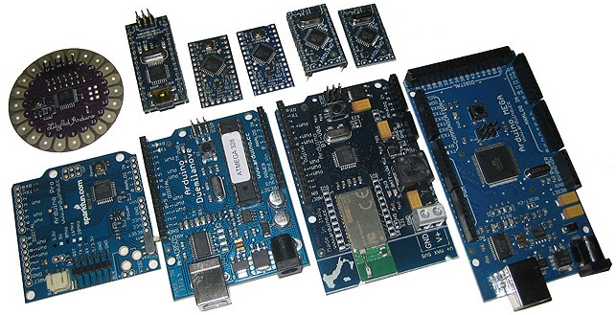
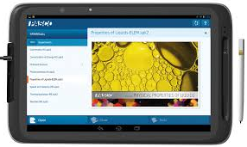
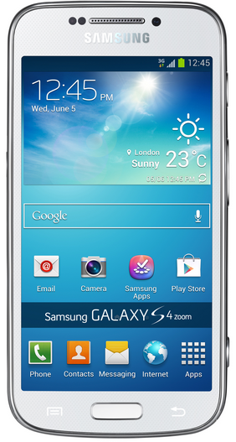
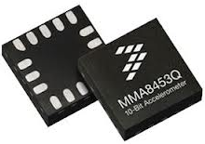


Prototype 2: Easyconnect as IoT Hub – 2 - Real-time data
TI CC2541
Data Visualization
Sensors
Easyconnect
Classmate Tablet Android
BLE -> wireless
wifi
Notification
BLE
No Internet need, Easyconnect is the data center.

Slide 6
Prototype 2: Easyconnect as IoT Hub - 2 - SW Architecture
Efforts
Hardware
Make a device based on existing development board
Write MCU code for BLE and sensors
Software
Port CKAN on Easyconnect.
Integrate BLE stack on Easyconnect
Develop the daemon for BLE client management.
Develop the daemon to pull data from BLE client to save to CKAN Data Portal
Develop data visualization web server
Develop event trigger daemon to send event via wireless
Develop Android app run in CMPC to receive and display the event.
Note: Need 1~2 GB for 3~4 months for Software only
Easyconnect
BLE Client Manager Daemon
Real-time
Collector
Daemon
Data Visualization Web Server
Event Trigger Daemon
BLE GAP
CKAN Data Portal
Easyconnect
Base Linux System

Slide 7

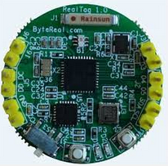
Prototype 3: iBeacon - Demo Script
iBeacon Wearable
Fix in the wall
iBeacon Wearable
wifi
Fix in the wall
Notification
Easyconnect
Teacher PC
iBeacon Wearable
Fix in the wall

Slide 8
Prototype 3: iBeacon - SW Architecture
Easyconnect
Efforts
Software.
Integrate BLE stack on Easyconnect
Develop the daemon for BLE client management.
Develop Classroom student Dashboard Webserver
Note: Need 1~2 GB for 3~4 months for Software only
BLE Client Manager Daemon
Real-time
Collector
Daemon
Classroom Student Dashboard Webserver
BLE GAP
Easyconnect
Base Linux System

